Slide 1

Air Travel is Safer than Motor Vehicle Travel
Ajuni Sohota
DSC 640

Slide 2

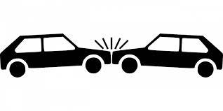
Even though Planes are
Much Safer than Air Travel:
There is a stigma and fear amongst travelers
We need funding to spread awareness of the statistics behind fatalities of car travel vs. air travel
Most importantly due to huge setbacks in air travel revenues due to Covid-19
<

Slide 3
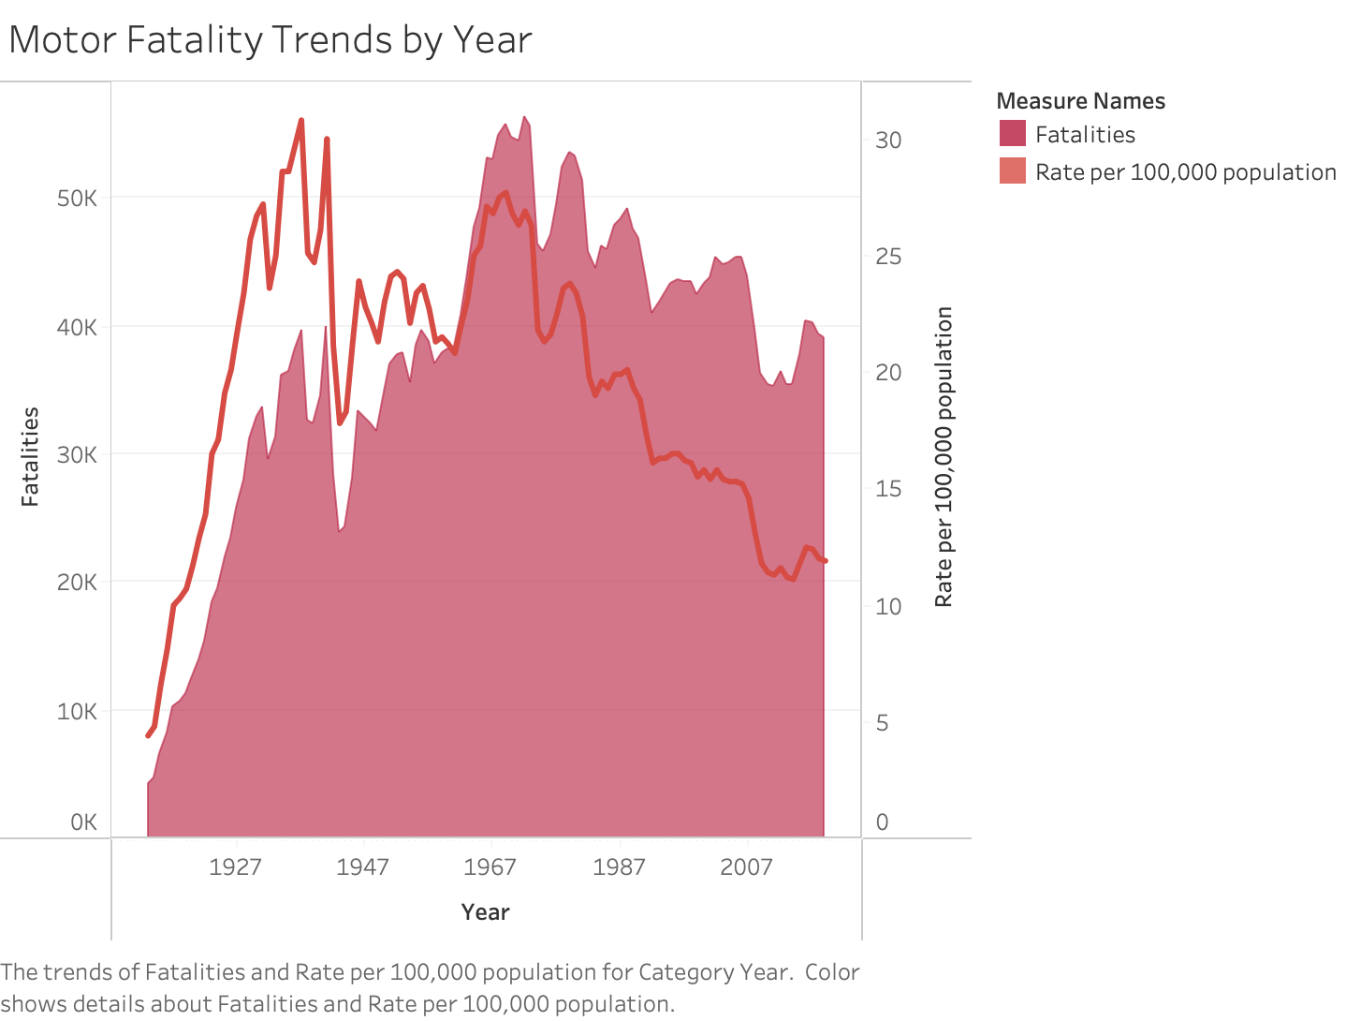

Car Crash Fatalities by Population and Overall
The odds of dying in a car crash in the U.S. as of 2019 is 1 in 107 people. In 2019, 39,107 died from motor vehicles.
Seatbelts were only put in cars in 1968

Slide 4
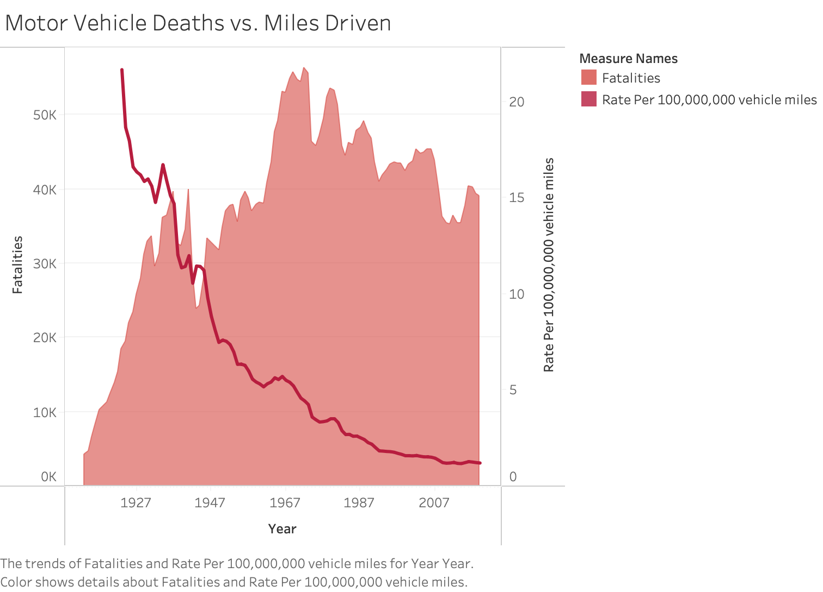
Fatalities Remain High in Motor Related Crashes
Mileage death rate for car crashes decrease while overall fatalities stay high, reiterating the unsafety in traveling long distances via car.

Slide 5
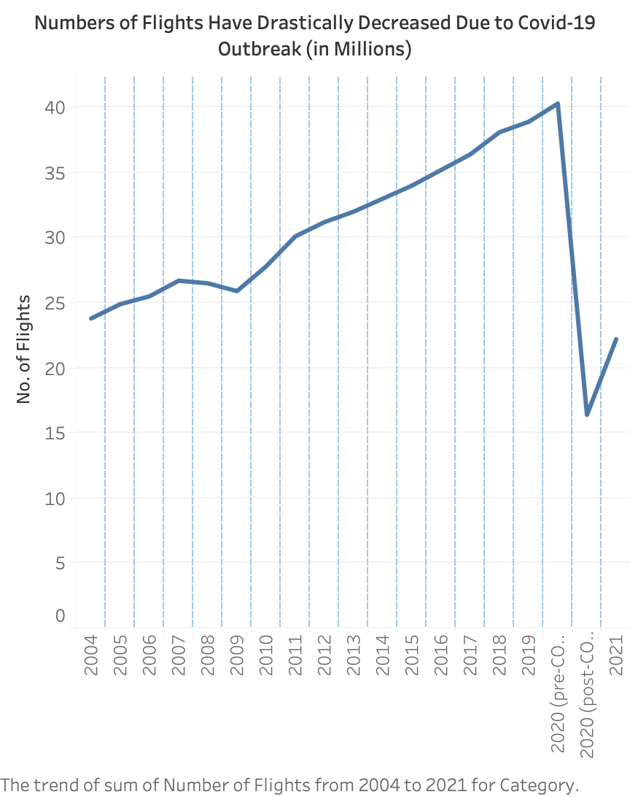
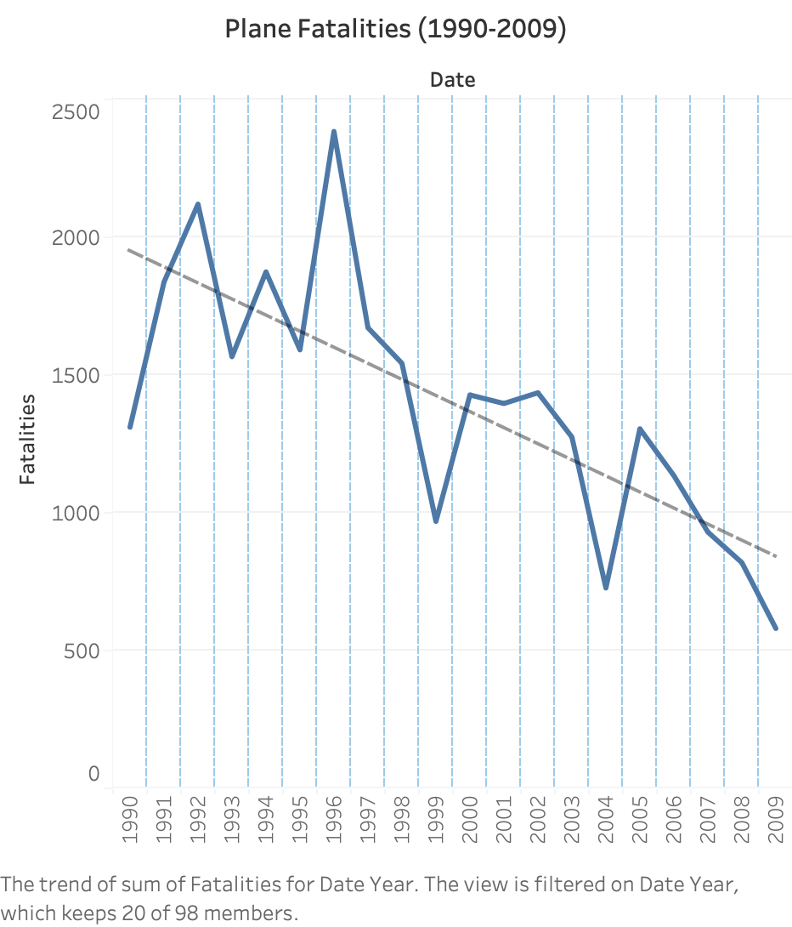
The probability of dying from Covid which you contracted while flying is less than 1 in 4.7 million

Slide 6
Car Crash Fatalities Are
More Common Than Plane Crash Fatalities:
Road crashes are the leading cause of death for people aged 1-54
38,000 people die from car crashes per year in the U.S.
Car fatalities remain high despite the invention of seatbelts
Plane Fatalities are Decreasing and were totaling 299 fatalities in 2020.
Because Flights have drastically decreased due to Covid-19, it is of utmost importance to reestablish safety in air travel
Odds of dying in a plane crash are too few to be calculated

Slide 7
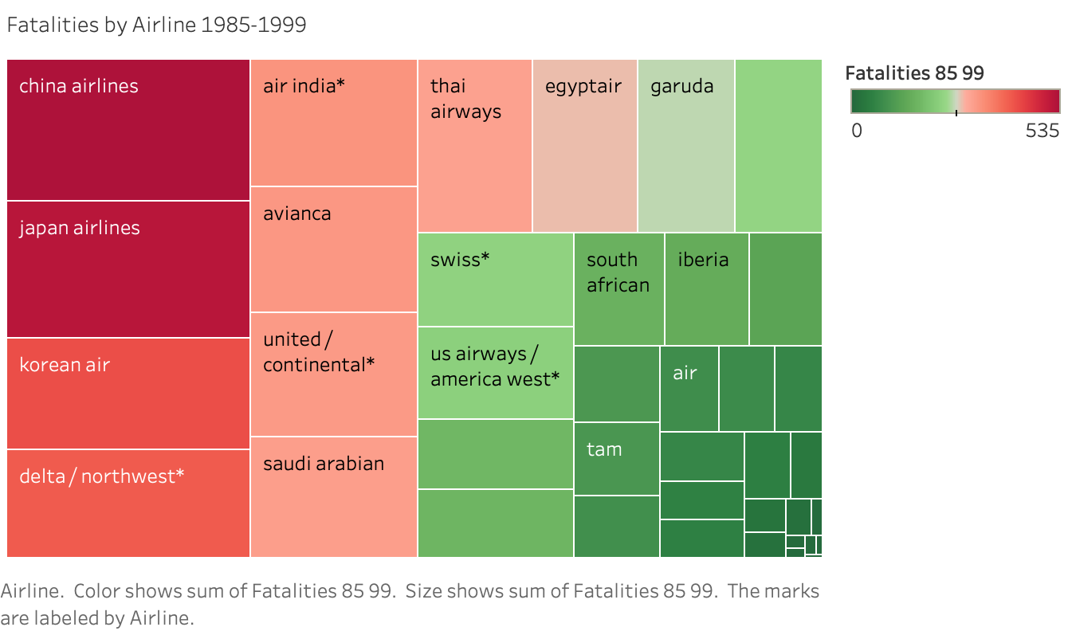
Top Airlines That Need The Most Help With Safety Image: China, Japan, Korean Air
Shows the airlines that have the highest death rates from 1985-1999. These airlines are where we need to focus our efforts to distinguish ourselves from.

Slide 8
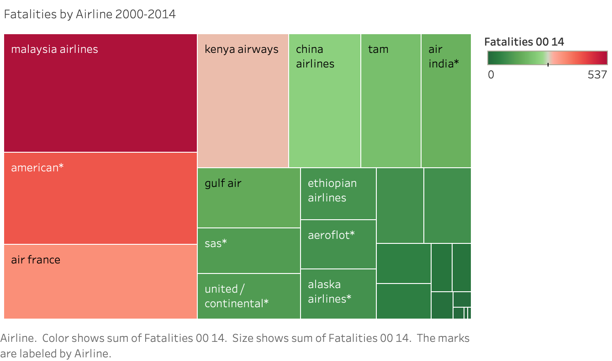
Top Three Airlines That Need The Most Help With Safety Image: Malaysia, American, Air France
Shows the airlines that have the highest death rates from 2000-2014. These airlines are where we need to focus our efforts to distinguish ourselves from.

Slide 9
Airlines To Target for Outreach Funding and Need Help with Their Safety Image
We can reassure customers that these airlines are committed to safety
Airlines to Target for Funding: China, Japan, Korean Air, Malaysia, American, Air France
Reiterating that 1 in 107 people will die from a motor related accident per year will allow travelers to feel better about air travel.

Slide 10
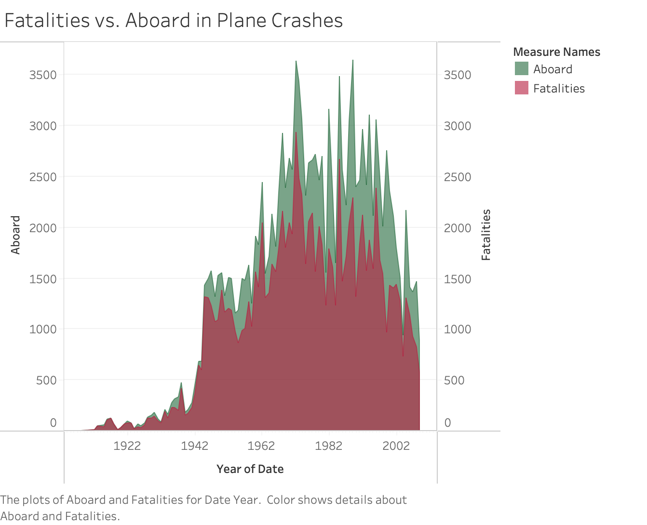
Fatalities Decrease in Those Aboard Plane Crashes
The chances of dying in a plane crash look high based on fatalities of those aboard a car crash, however, the odds of dying in a plane crash as of 2019 (U.S.) are too few to calculate.

Slide 11
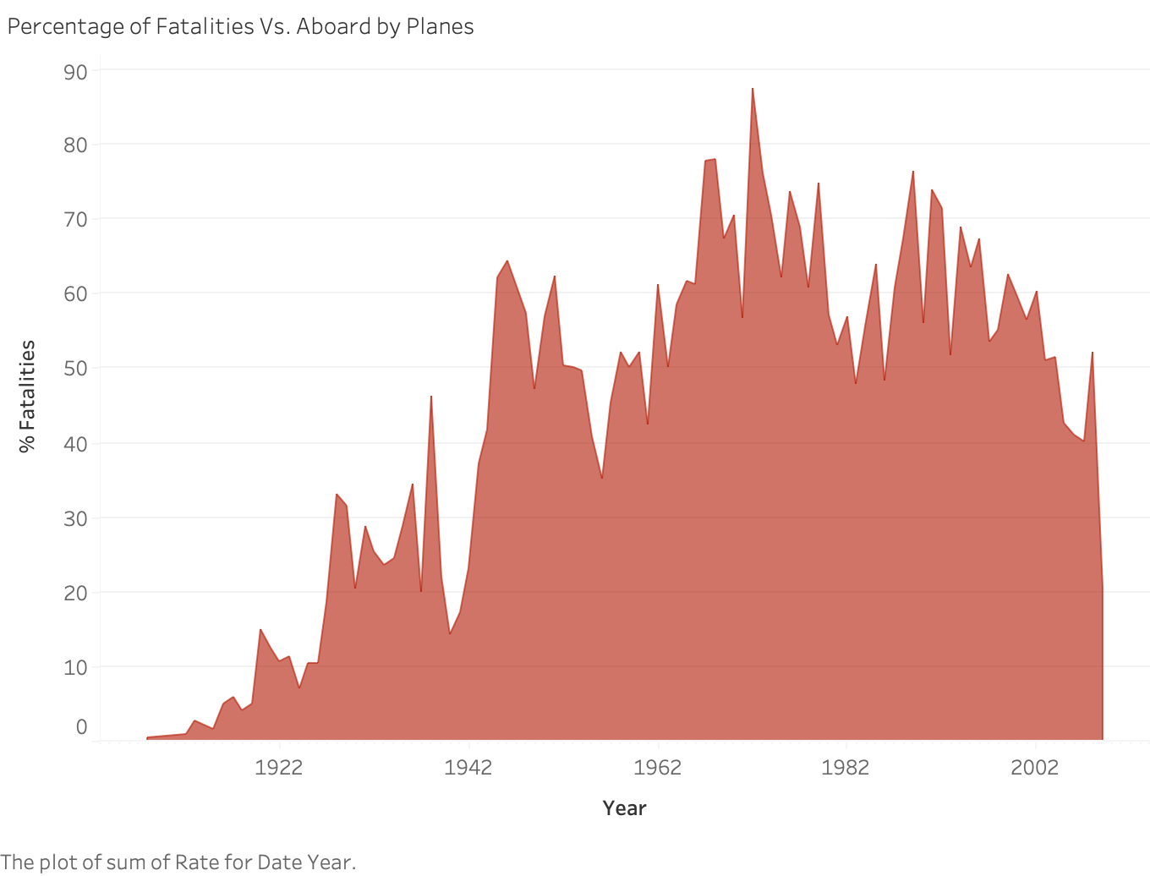
Percentage of Fatalities from Those Aboard Plane Crashes
The percentage of fatalities of people aboard in a plane crash is on a downward trend.

Slide 12
Plane Fatalities are Decreasing
38,680 people died in car crashes in the U.S. in 2020 alone compared to the 299 total that died from air travel worldwide.
Bad press for airlines with the highest fatalities is motivation to fund this safety outreach program.
Thank you for your consideration!

